Slide 1


Bhaveshkumar Jadav
11/11/2023

Slide 2

Outline
Executive Summary
Introduction
Methodology
Results
Conclusion
Appendix

Slide 3
Executive Summary
Accuracy of result depends on data and source of data.
Payload Mass having in range 2k-4k has higher success ratio.
KSC LC-39A site has highest success ratio.
FT booster version is most successful version having highest success rate.

Slide 4

Introduction
SpaceX's Falcon 9, renowned for its cost-effectiveness driven by first stage reusability, stands as a pioneering example in the aerospace industry.
This capstone project aims to leverage predictive modeling to determine the success of Falcon 9 first stage landings, a crucial factor influencing the overall cost of a launch. By analyzing historical data encompassing various launch parameters, mission outcomes, and contextual features, the project seeks to build a robust machine learning model capable of forecasting the likelihood of a successful landing.
This capstone project encompasses a comprehensive methodology, including data collection, preprocessing, feature engineering, model selection, and evaluation.
The significance of this endeavor lies in its potential impact on cost competitiveness within the space launch industry. Accurate predictions regarding the Falcon 9's first stage landing success not only contribute to mission planning and execution but also empower competing entities to strategically position themselves in bidding scenarios. With SpaceX's reusability driving down launch costs, an effective predictive model can assist alternate companies in formulating competitive bids, fostering a dynamic and cost-efficient environment in the space exploration domain.

Slide 5

Section 1

Slide 6
Methodology
Executive Summary
Data collection methodology:
Data collected using SpaceX API and Web Scrapping from Wikipedia information.
Perform data wrangling
Replacing missing values with Mean value of column(e.g. column: PayloadMass)
Perform exploratory data analysis (EDA) using visualization and SQL
Perform interactive visual analytics using Folium and Plotly Dash
Perform predictive analysis using classification models
Select different classification models and find best parameters for tunning and last evaluate accuracy and precision

Slide 7
Data Collection
Identified different source of data such as SpaceX data API and Web Scraping methods And collected data from sources.
SpaceX API
Web Scraping data from Wikipedia
Data

Slide 8
Data Collection – SpaceX API
Couple of API used to collect data as shown in right section.
https://github.com/radhe004/DataScienceCapstone/blob/main/jupyter-labs-spacex-data-collection-api.ipynb
SpaceX APIs
launches
getLaunchSite
Data
getBoosterVersion
getPayloadData
getCoreData

Slide 9
Data Collection - Scraping
Collected data from Wikipedia page by web scraping using BeautifulSoup.
Wiki URL: https://en.wikipedia.org/wiki/List_of_Falcon_9_and_Falcon_Heavy_launches
https://github.com/radhe004/DataScienceCapstone/blob/main/jupyter-labs-webscraping.ipynb
URL
Download data from URL
Parsing HTML data
Extract columns and Variables
Extracted data stored in Panda Data frame
Data stored to CSV File

Slide 10
Data Wrangling
Cleaned the data
Organizing raw data into a format suitable for analysis
https://github.com/radhe004/DataScienceCapstone/blob/main/labs-jupyter-spacex-Data%20wrangling.ipynb

Slide 11
EDA with Data Visualization
I have scatter plot chat Because it help to visualize the relationship between two variables.
I plotted a bar chart So that we can do comparison.
I also plotted line chart to visual launch success yearly trend
Following Chart Plotted:
Flight Number vs Payload Mass, Flight Number vs Launch Site, Payload vs Launch Site, Flight Number vs Orbit type, Payload vs Orbit type, Success rate of each orbit type, Launch success yearly trend
https://github.com/radhe004/DataScienceCapstone/blob/main/jupyter-labs-eda-dataviz.ipynb.jupyterlite.ipynb

Slide 12
EDA with SQL
Summarization of the SQL performed queries
Unique launch site names in the space mission
5 records where launch sites begin with the string 'CCA’
The total payload mass carried by boosters launched by NASA (CRS)
Average payload mass carried by booster version F9 v1.1
List the date when the first successful landing outcome in ground pad was achieved
List the names of the boosters which have success in drone ship and have payload mass greater than 4000 but less than 6000
List the total number of successful and failure mission outcomes
The names of the booster versions which have carried the maximum payload mass using sub query
List the records which will display the month names, failure landing_outcomes in drone ship ,booster versions, launch_site for the months in year 2015.
Rank the count of landing outcomes (such as Failure (drone ship) or Success (ground pad)) between the date 2010-06-04 and 2017-03-20, in descending order.
https://github.com/radhe004/DataScienceCapstone/blob/main/jupyter-labs-eda-sql-coursera_sqllite.ipynb

Slide 13
Build an Interactive Map with Folium
I have used Markers, Circles, Lines and following is the detail for being used these objects:
Marker - Used to pinpoint specific locations on the map
Circle – To draw a circle around a specified point on the map
Line – To connect multiple points on the map and draw line for showing distance
https://github.com/radhe004/DataScienceCapstone/blob/main/lab_jupyter_launch_site_location.ipynb

Slide 14
Build a Dashboard with Plotly Dash
I have created dashboard application with the Python Plotly Dash Package
This dashboard application contains input components such as a dropdown list(location site selection) and a range slider(Payload selection) to interact with a pie chart and a scatter point chart
You can analysis data using dashboard that success launch ratio of sites; also to visualize payload mass for booster version category and its success.
https://github.com/radhe004/DataScienceCapstone/blob/main/spacex_dash_app.py

Slide 15
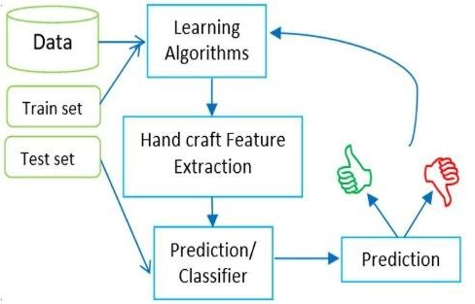
Predictive Analysis (Classification)
Created a class column(output variable)
Standardize the data, Created training and test data. here test size used 0.2.
Used different Classification Models such as SVM, Classification Trees and Logistic Regression.
Used Grid Search to find the best tuned parameters for prediction
Check Accuracy and Confusion matrix for validating model
https://github.com/radhe004/DataScienceCapstone/blob/main/SpaceX_Machine_Learning_Prediction_Part_5.jupyterlite.ipynb

Slide 16
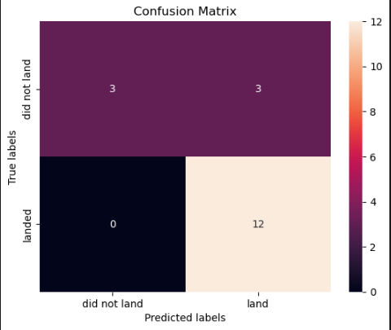
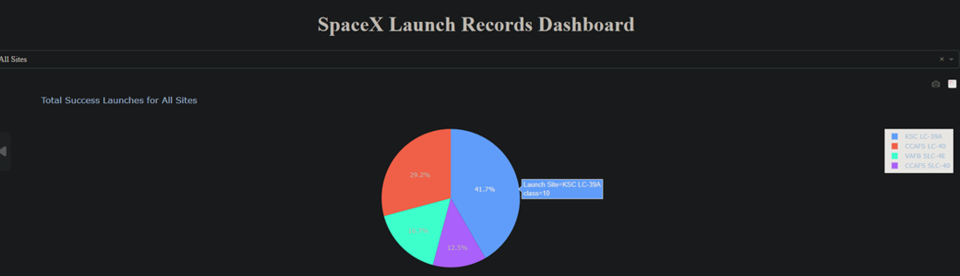
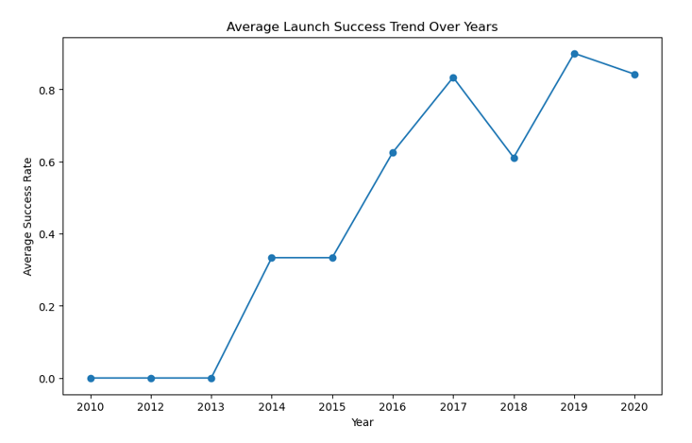
Results
Exploratory data analysis results - The success rate since 2013 kept increasing till 2020
Interactive analytics demo in screenshots - KSC LC-39A site has highest success ratio. 2-4k Payload mass range having good success ratio.
Predictive analysis results – Best Model Confusion Matrix shown.

Slide 17

Section 2

Slide 18
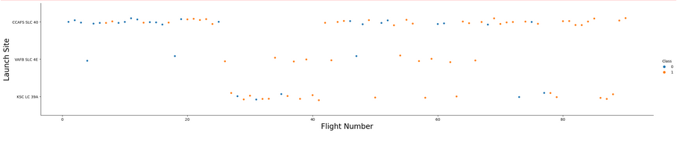
Flight Number vs. Launch Site
Show a scatter plot of Flight Number vs. Launch Site
Success ratio is increasing along with flight number

Slide 19
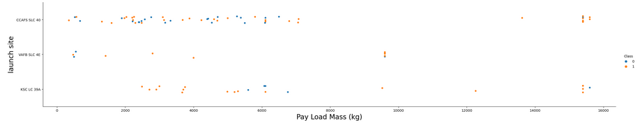
Payload vs. Launch Site
Show a scatter plot of Payload vs. Launch Site
VAFB-SLC launch site there are no rockets launched for heavy payload mass(greater than 10000).

Slide 20
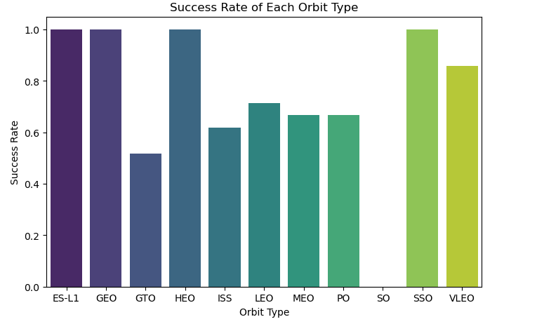
Success Rate vs. Orbit Type
Show a bar chart for the success rate of each orbit type
ES-L1, GEO, HEO, SSO having higher success ration as compared to others.

Slide 21
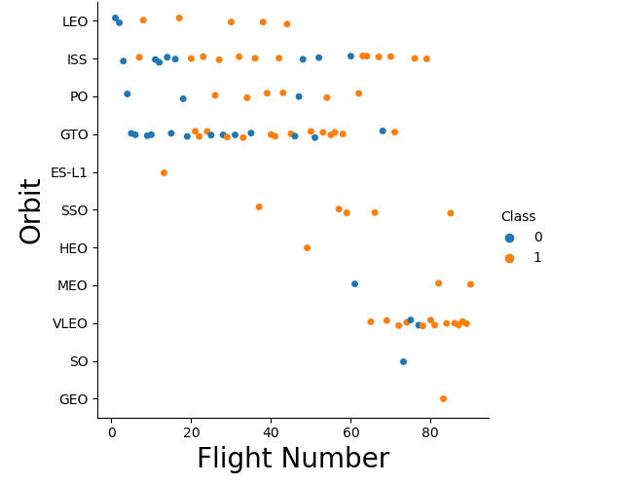
Flight Number vs. Orbit Type
Show a scatter point of Flight number vs. Orbit type
LEO orbit the Success appears related to the number of flights; on the other hand, there seems to be no relationship between flight number when in GTO orbit.

Slide 22
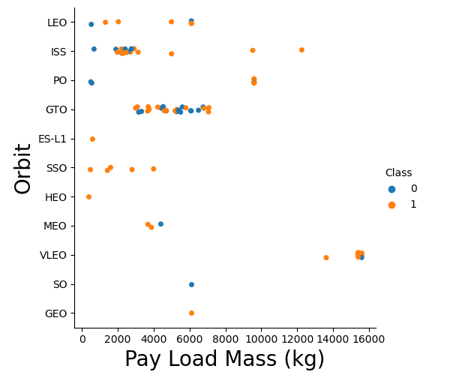
Payload vs. Orbit Type
Show a scatter point of payload vs. orbit type
GTO we cannot distinguish as we have both values.
With heavy payloads the successful landing or positive landing rate are more for Polar, LEO and ISS

Slide 23
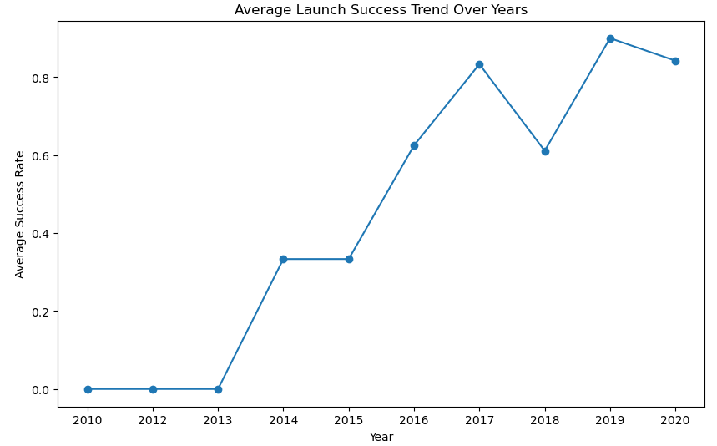
Launch Success Yearly Trend
Show a line chart of yearly average success rate
The success rate since 2013 kept increasing till 2020

Slide 24
All Launch Site Names
Unique launch sites
CCAFS LC-40
VAFB SLC-4E
KSC LC-39A
CCAFS SLC-40
This give unique launch sitename from spacextable. Disticnt keywork gives unique values.

Slide 25
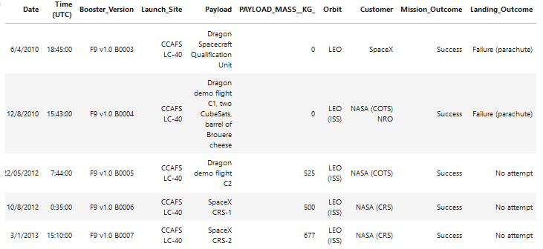
Launch Site Names Begin with 'CCA'
Find 5 records where launch sites begin with `CCA`
Limit function used to get 5 records.

Slide 26
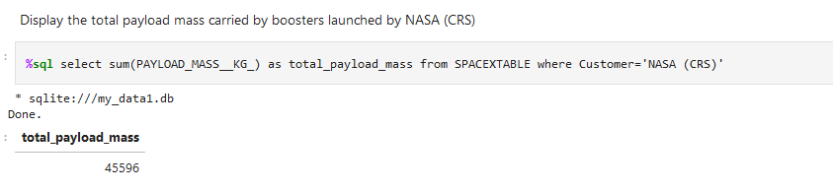
Total Payload Mass
Total Payload Mass carried by boosters launched by NASA

Slide 27
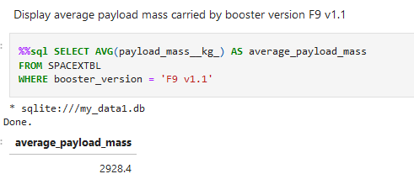
Average Payload Mass by F9 v1.1
Calculate the average payload mass carried by booster version F9 v1.1
Query use AVG SQL function to calculate average

Slide 28
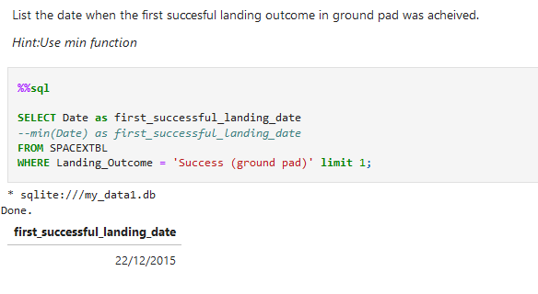
First Successful Ground Landing Date
Dates of the first successful landing outcome on ground pad as shown below

Slide 29
Successful Drone Ship Landing with Payload between 4000 and 6000
List the names of boosters which have successfully landed on drone ship and had payload mass greater than 4000 but less than 6000
F9 FT B1022
F9 FT B1026
F9 FT B1021.2
F9 FT B1031.2
Used multiple and clauses

Slide 30
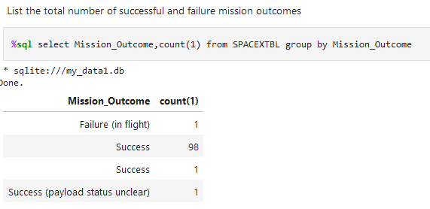
Total Number of Successful and Failure Mission Outcomes
The total number of successful and failure mission outcomes
Used aggregate functions.

Slide 31
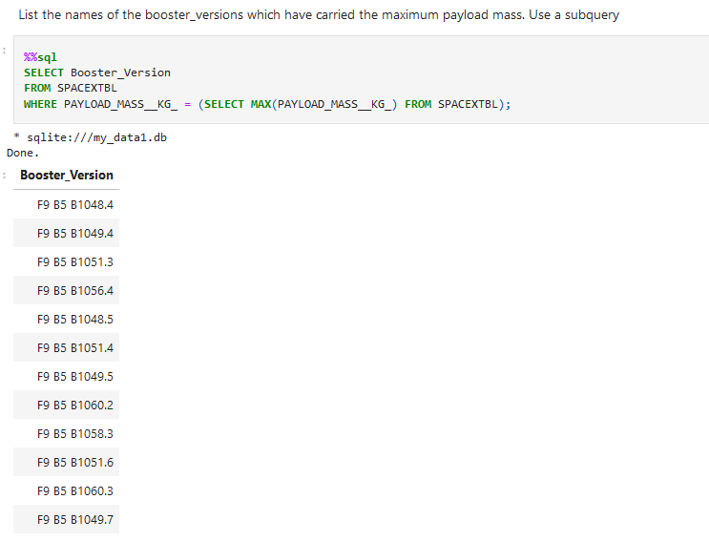
Boosters Carried Maximum Payload
List the names of the booster which have carried the maximum payload mass
SQL Sub query is used.

Slide 32
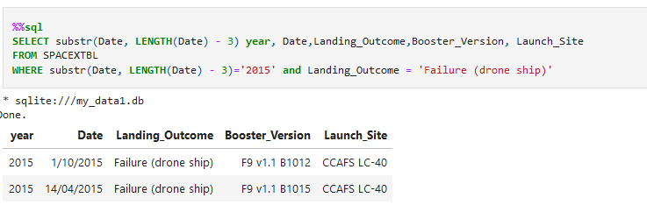
2015 Launch Records
List the failed landing_outcomes in drone ship, their booster versions, and launch site names for in year 2015
Used substr and LENGTH function to get Year

Slide 33
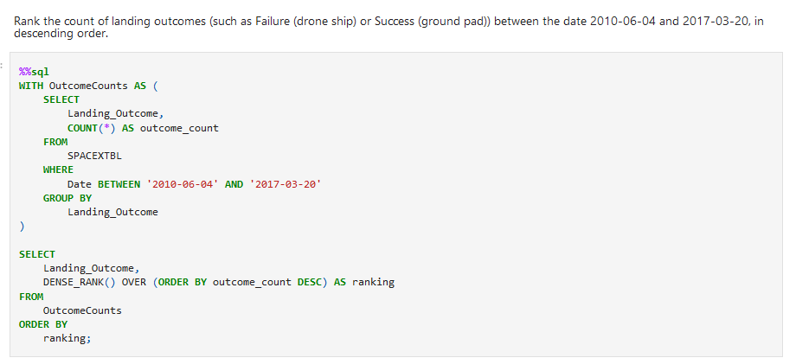
Rank Landing Outcomes Between 2010-06-04 and 2017-03-20
Rank the count of landing outcomes (such as Failure (drone ship) or Success (ground pad)) between the date 2010-06-04 and 2017-03-20, in descending order
Use many SQL function such like BETWEEN, COUNT, GROUP BY, DENSE_RANK…

Slide 34

Section 3

Slide 35
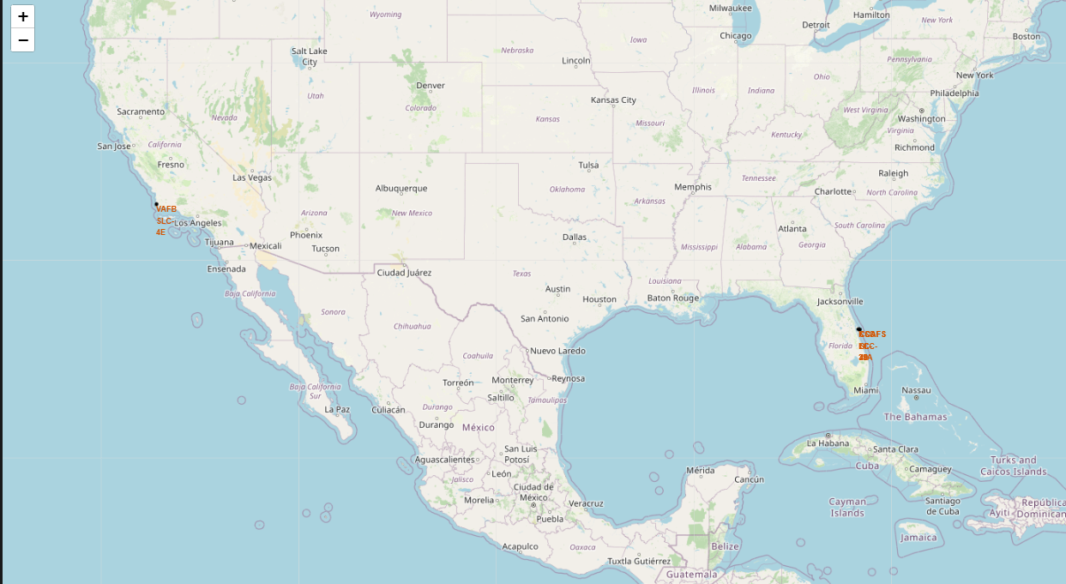
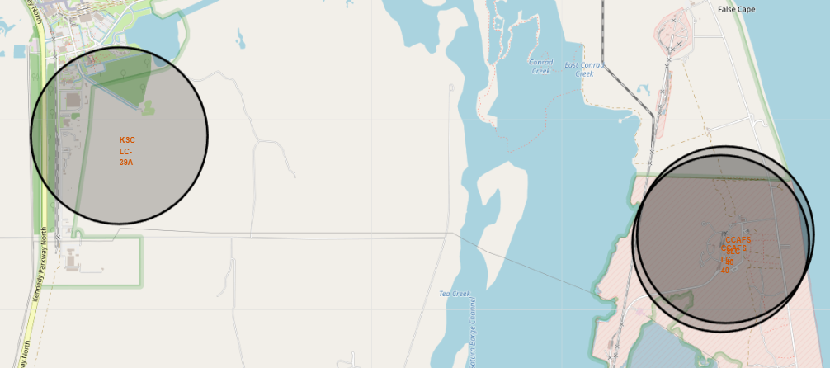
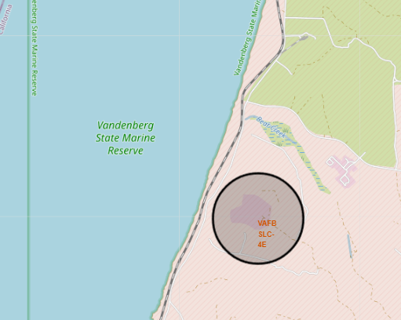
SS1: ALL LAUNCH SITES LOCATIONS LOCATED
Launch Sites Locations

Slide 36
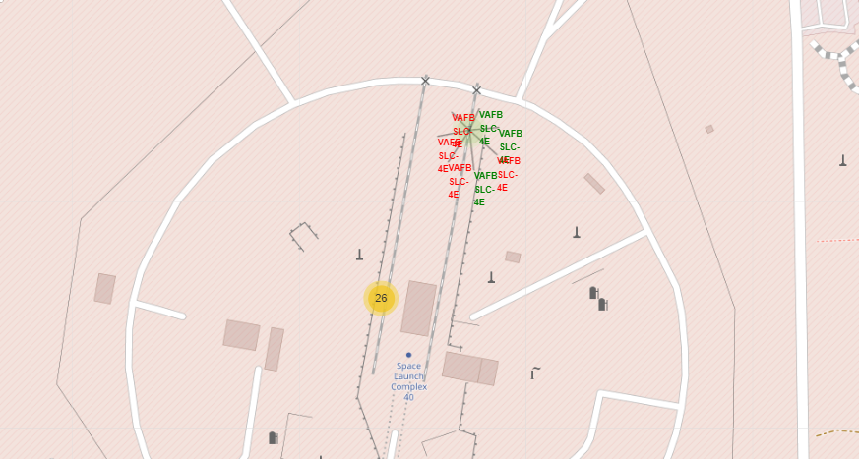
Site SLC 40 Launch Success/Failure
Below screenshot shows green are successful launched and red are failure.

Slide 37
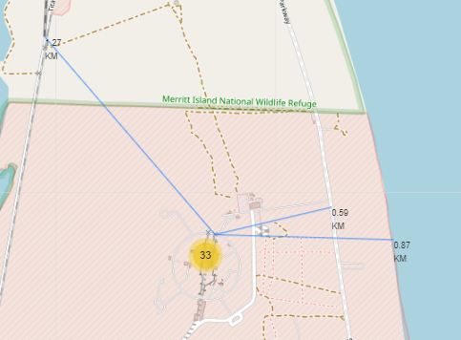
Launch site to its proximities such as railway, highway, coastline, with distance
Site and Railway distance is 1.27 KM
Site and Coastline distance is 0.87 KM
Site and Highway distance is 0.59 KM

Slide 38

Section 4

Slide 39
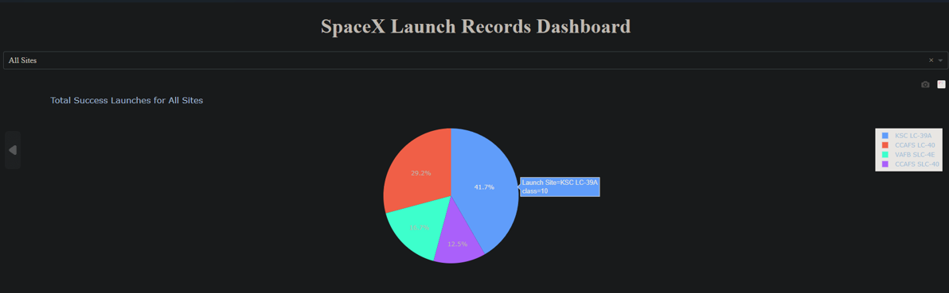
Launch success count for all sites – Pie Chart
Four sites success launch percentage are shown.
KSC LC-39A having highest percentage.

Slide 40
KSC LC-39A having highest success ratio.
It has 41.7% success ratio.

Slide 41
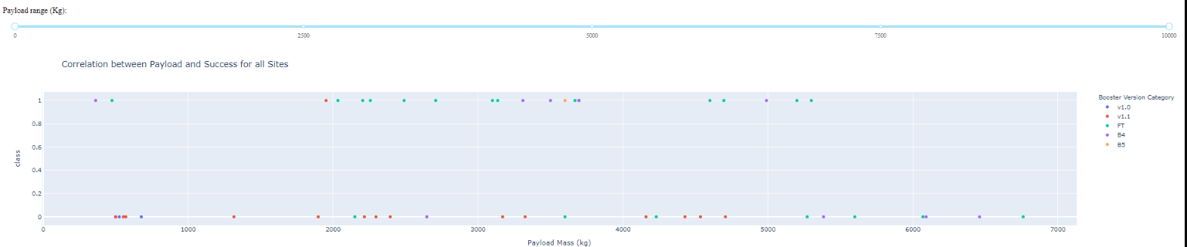
Corelation between Payload and Success for all sites
Shown screenshot of Payload vs. Launch Outcome scatter plot for all sites, with different payload selected in the range slider
FT booster version has highest success, second highest success booster version is B4
Payload Range 2000-4000 having highest success ratio.

Slide 42

Section 5

Slide 43
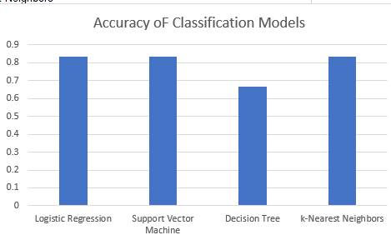
Classification Accuracy
Logistic Regression, Support Vector Machine, KNN has highest accuracy 0.8333333333333334

Slide 44
Confusion Matrix
Show the confusion matrix of the best performing mode.
It has highest sum of true positives and true negatives so This is good model.

Slide 45
Conclusions
Reusable falcon 9 rocket reduce much cost.
Payload Mass having in range 2k-3k has higher success ration.
KSC LC-39A site has highest success ratio.
FT booster version is most successful version having highest success rate.

Slide 46
Appendix
Capstone Project Files: https://github.com/radhe004/DataScienceCapstone

Slide 47
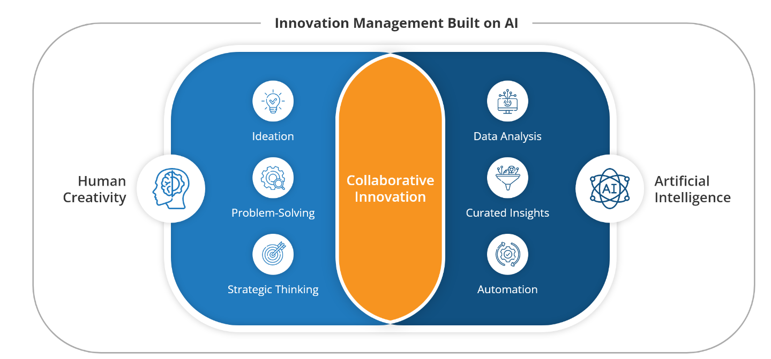
Innovative Insights
Explainable AI (XAI): Increasing focus on making AI systems transparent and understandable, particularly in sensitive domains.
AI for Generative Creativity: Most Utilization of AI in creative fields such as art, music, and literature for generating original content.
AI for Generative Creativity: Exploration of the intersection between quantum computing and AI for more efficient solutions to complex problem
AI-driven Drug Discovery: Acceleration of drug discovery processes through AI analysis of large datasets to identify potential drug candidates.
AI in Healthcare: Integration of AI for diagnostics, personalized medicine, and drug discovery, with applications in medical image analysis and treatment optimization.
1.

Slide 48


